Slide 4
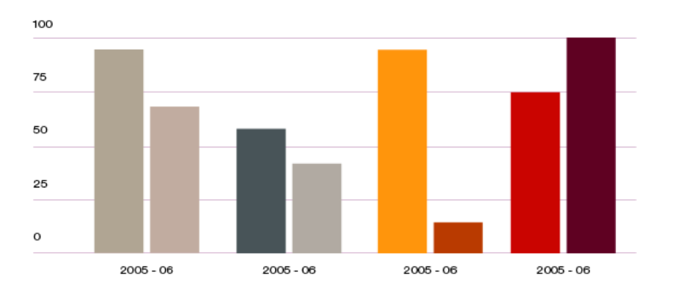

Slide 5
ECC Contact | Web www.cept.org/ecc
ECO Nyropsgade 37, 4th floor DK-1602 Copenhagen Tel:+45 33 89 63 00 E eco@eco.cept.org

